Slide 1


Customer Shopping Behavior Analysis
This project analyzes customer purchasing patterns to extract actionable business insights, integrating Python, MySQL, and Power BI for an end-to-end data pipeline.

Slide 2
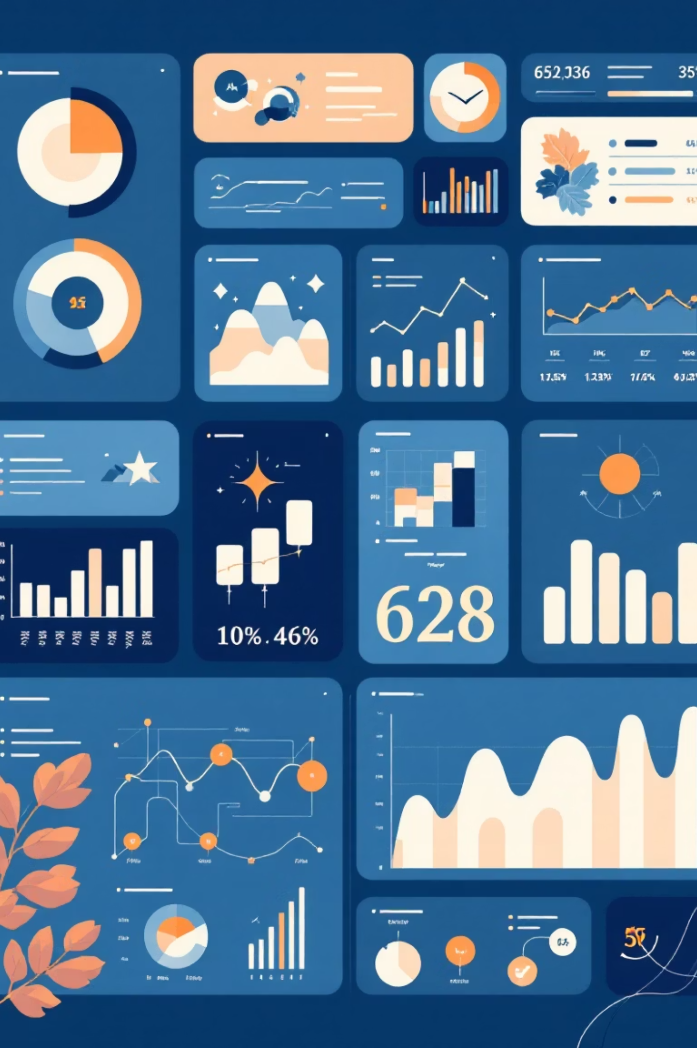
Project Overview & Dataset Summary
Project Goal
Rows
Understand customer behavior, identify profitable segments, and make data-driven decisions through comprehensive analysis.
3,900
Dataset Details
Columns
The dataset contains 3,900 customer transactions across 18 features, including demographics, product categories, and subscription behavior.
18
Key Features
Age, Gender, Purchase Amount, Category, Review Rating
Missing Values
37 in Review Rating

Slide 3
Python Workflow: Data Cleaning & EDA
The initial stage involved Exploratory Data Analysis and Data Cleaning using Jupyter Notebook.
01
02
03
Load Dataset
Structure Check
Missing Values
Loaded data using pandas.read_csv().
Basic structure and info check using .info().
Identified and imputed 37 missing values in 'Review Rating'.
04
05
Feature Engineering
MySQL Connection
Created 'Age Group' and 'purchase_frequency_days' columns.
Connected Python to MySQL and imported the cleaned dataset.

Slide 4
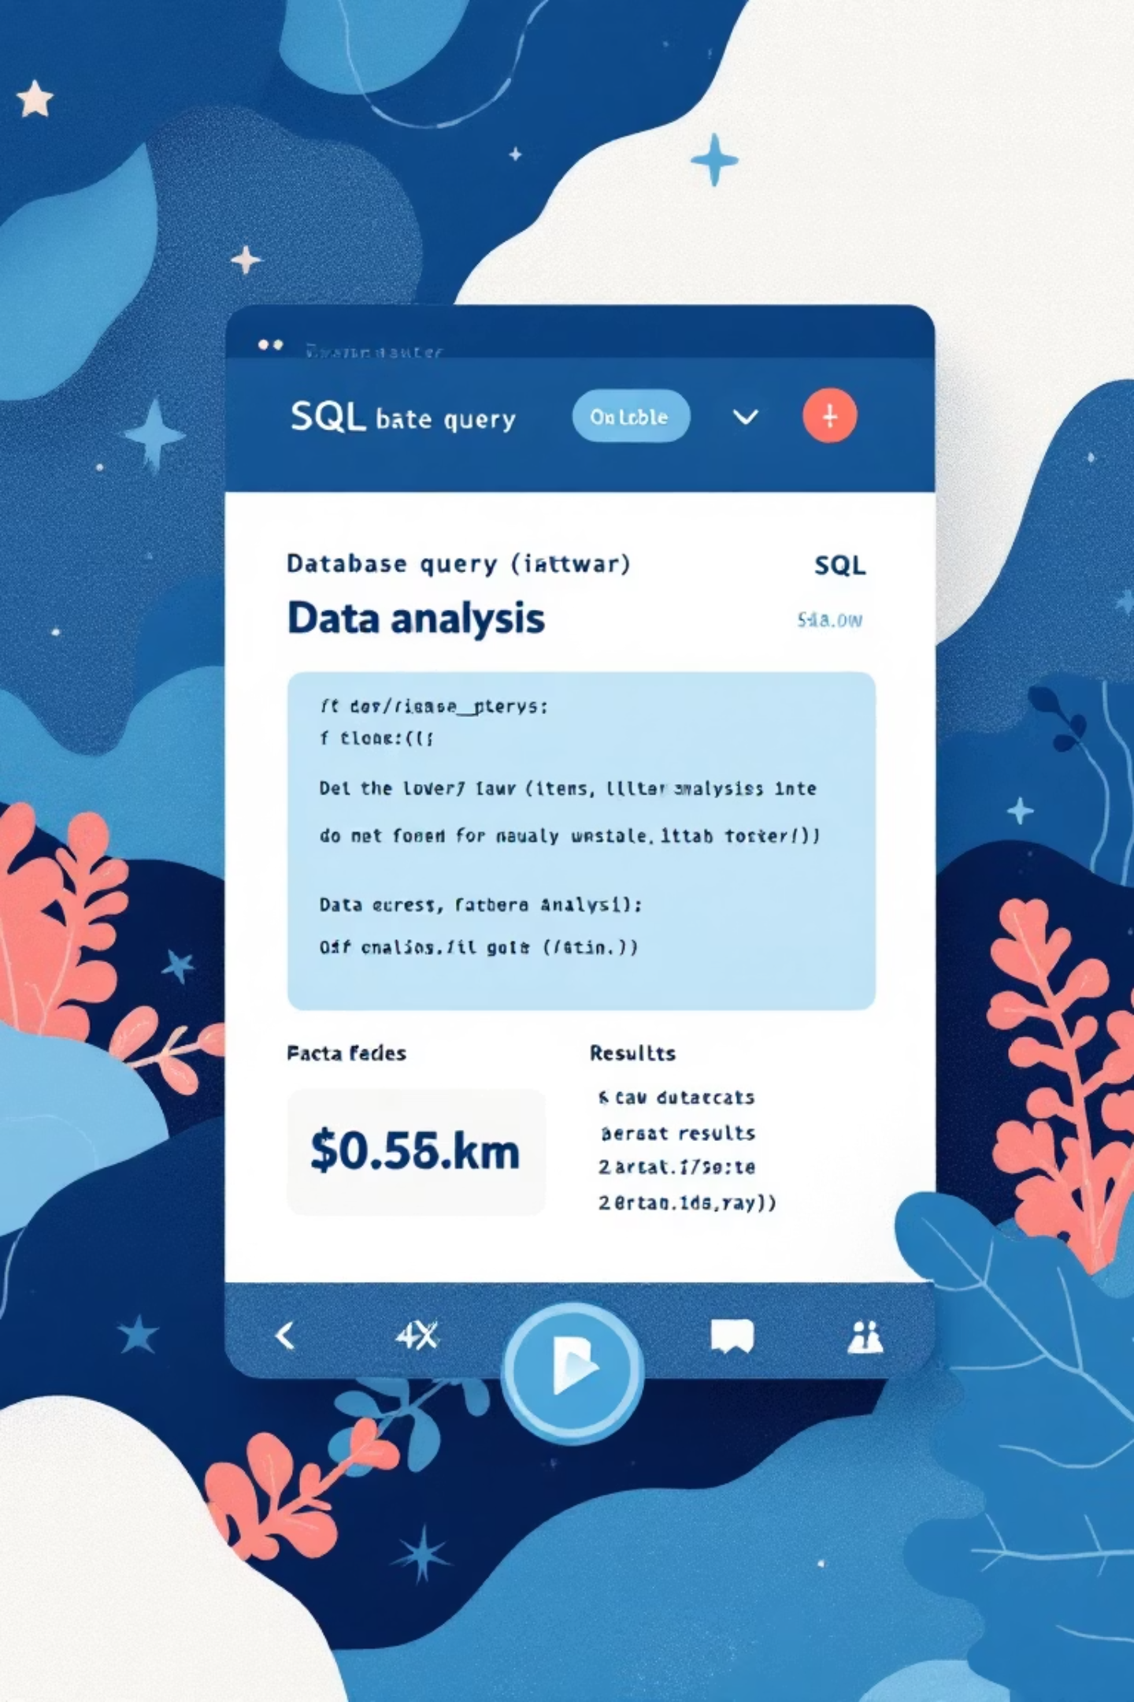
SQL Analysis: Key Business Questions
Cleaned data was loaded into MySQL for critical business question analysis.
1
Revenue by Gender
Male: $157,890, Female: $75,191.
2
Discount & Spend
Customers using discounts who spent above average identified.
3
Top 5 Products
Gloves, Sandals, Boots, Hat, Skirt by review rating.
4
Customer Segmentation
Loyal (3116), Returning (701), New (83) customers identified.

Slide 5

Power BI Dashboard: Interactive Visualization
An interactive analytical dashboard was designed in Power BI, featuring slicers, filters, KPIs, bar charts, and donut charts.
Dashboard KPIs
DAX Measures Used
Total Customers
Total Customers: COUNT(customer[customer_id])
Average Purchase Amount
Avg Purchase Amount: AVERAGE(customer[purchase_amount])
Average Review Rating
Subscription %: DIVIDE(CALCULATE(COUNT(...)))
Revenue by Category/Age Group
Total Revenue: SUM(customer[purchase_amount])
Sales by Category
% Customers by Subscription Status

Slide 6
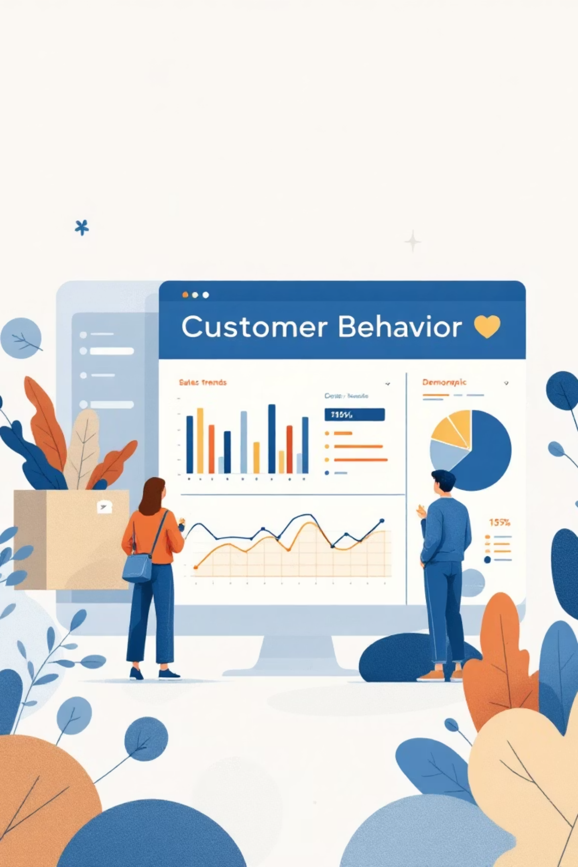




Key Insights & Customer Behavior
Revenue Drivers
Young Adults and Middle-aged customers contribute the highest revenue.
Shipping Impact
Express shipping customers show higher spending.
Top Products
Gloves, Sandals, Boots, Hat, & Skirt are top-rated.
Category Popularity
Accessories and Clothing are the most purchased categories.

Slide 7
Business Recommendations & Conclusion
Strategic Recommendations
Unified Analytics Workflow
Promote subscription benefits for conversion.
This project showcases the power of integrating Python for cleaning, SQL for structured analysis, and Power BI for visualization.
Introduce loyalty rewards for returning customers.
Highlight best-rated and top-selling products.
Run targeted marketing campaigns for young adults.
Tool
Purpose
MySQL
Data storage, query processing
Python
Data cleaning, preprocessing
Power BI
Modeling, measures, visualization

